Slide 1
GLOBALIZATION:
7 Billion And Beyond

Slide 2
Lesson Warm-up: World Clock
After we visit the World Clock – Population Counter website, complete the predictions #1-5 on your response sheet!
http://www.poodwaddle.com/worldclock/

Slide 3
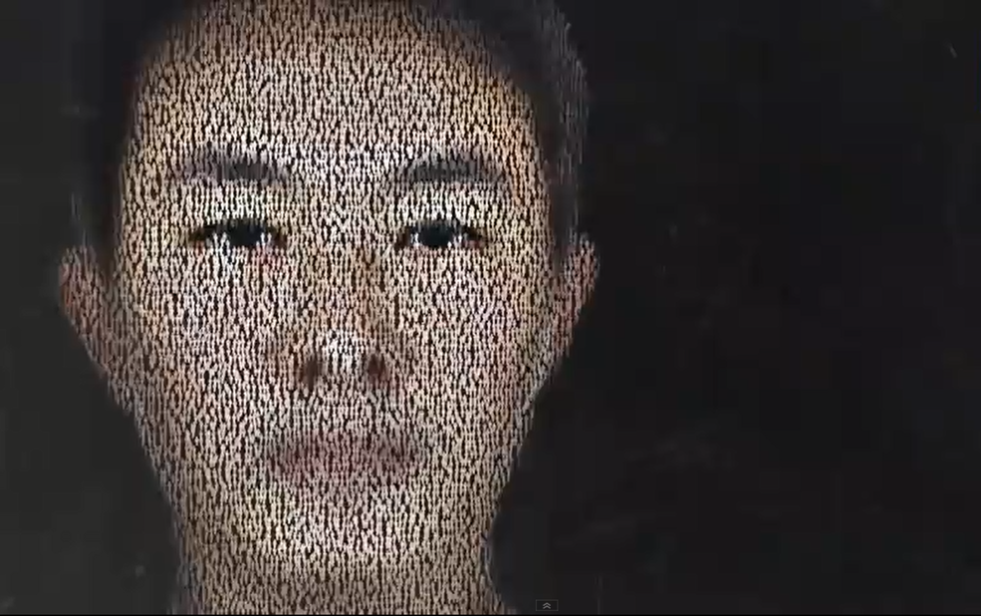
Lesson Warm-up: Who is this?
Prediction #6:
Who do you think this person is? Write a little bit about him/her.
What nationality? What age? What is the image so grainy?

Slide 4
Task 1: 7 Billion & Counting Video Clips Video #1
http://www.youtube.com/watch?v=sc4HxPxNrZ0

Slide 5
Task 1: 7 Billion & Counting Video Clips Video #2
http://www.youtube.com/watch?v=4B2xOvKFFz4

Slide 6
Task 1: 7 Billion & Counting Video Clips Video #3
http://www.youtube.com/watch?v=VcSX4ytEfcE

Slide 7
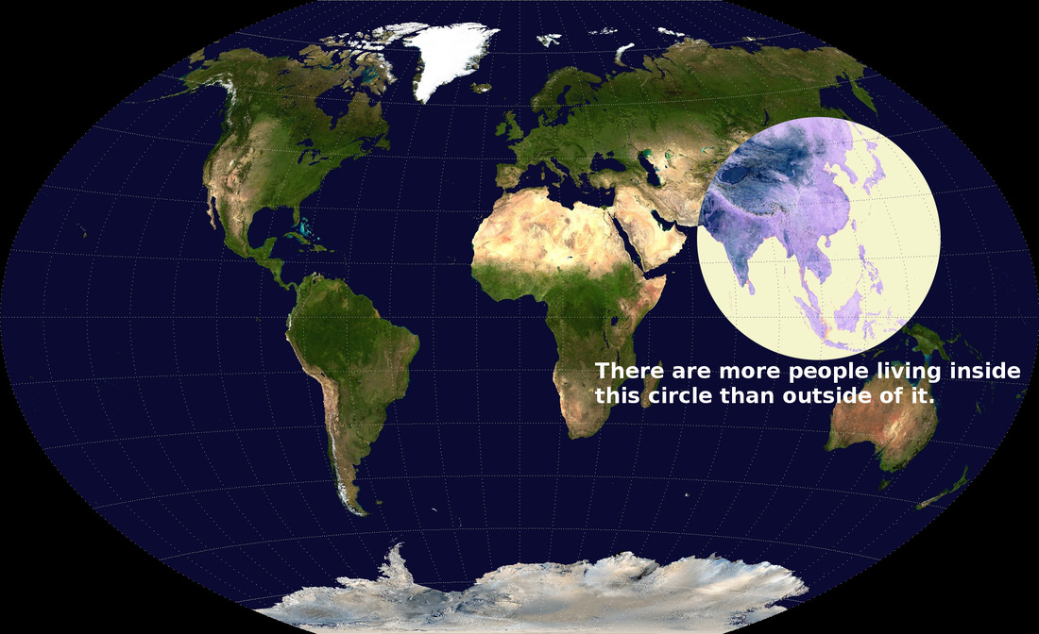

Slide 8
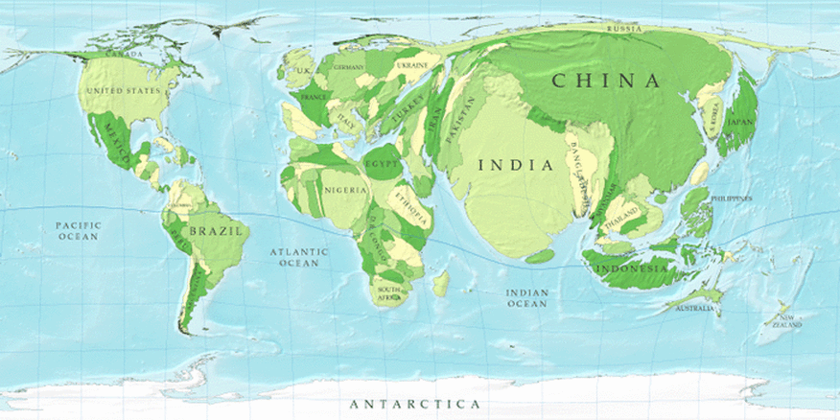
Population Distribution Map

Slide 9
Task 2: World Population Density & Percent Growth
Definitions:
POPULATION DENSITY: the number of people living per square area (mile, km, etc)
POPULATION GROWTH: the increase in the number of people living in a given area

Slide 10
Task 2: World Population Density & Percent Growth
How to calculate:

Slide 11
Population Density Example
U.S. Population (2016 Census): 322,762,018
U.S. Total Land Area: 3,794,000 sq. mi.
Population Density = 322,762,018
----------------------
3,794,000n sq. mi.
85 people/sq. mile

Slide 12
Population Percent Growth
U.S. Population (2013 Census): 322,762,018
U.S. Projected Population 2050: 399,800,000
23.86%

Slide 13
Population Density & Percent Growth Observations (if time)
What did you notice about the population densities in your chart?
What conclusions can you make about population percent growth in different parts of the world?

Slide 14
Lesson Conclusion: World Clock
Let’s revisit the World Clock counter from the beginning of class. Fill in the response questions in the “lesson closure” section of your worksheet.
http://www.poodwaddle.com/worldclock/

