Slide 1
AGE OF REVOLUTIONS VOCABULARY
Directions: Confirm or correct your responses on your Age of Revolutions Vocabulary!

Slide 2
NATIONAL ASSEMBLY
(1) Law making body in France that passed the Declaration of the Rights of Man

Slide 3
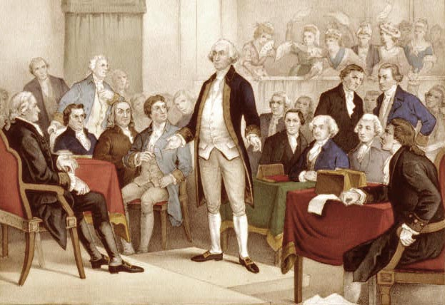
CONTINENTAL CONGRESS
(2) An assembly of delegates from the American colonies that issue the Declaration of Independence in 1776

Slide 4

DECLARATION OF INDEPENDENCE
(3) Document created that declared the 13 American Colonies independent from Britain. Passed by Continental Congress on July 4, 1776.

Slide 5
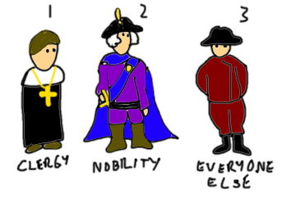
THIRD ESTATE
(4) Lowest estate of French society consisting of everyday French citizens (over 97% of the population)

Slide 6
SECOND ESTATE
(5) Noble families in French society

Slide 7
FIRST ESTATE
(6) Priests and religious leaders in French society (highest level)

Slide 8
TREASON
(7) The crime of betraying one's country

Slide 9
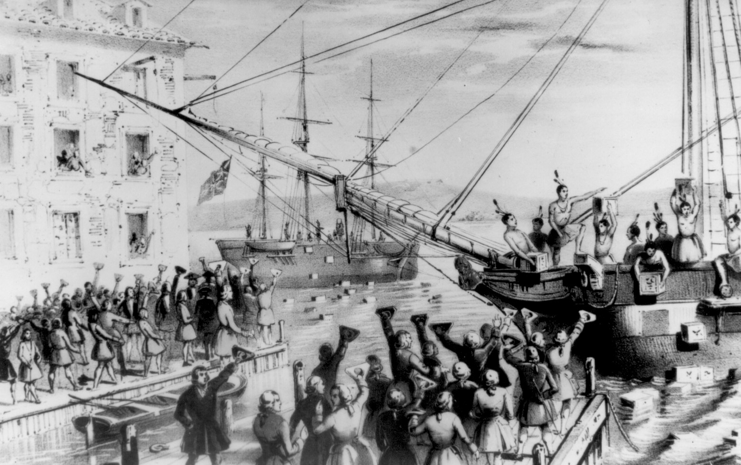
INTOLERABLE ACTS
(8) A series of British laws passed in 1774 designed to punish the American colonists by closing the port at Boston and banned town meetings

Slide 10

TENNIS COURT OATH
(9) Pledge signed by members of the Third Estate in 1789 that they would continue meeting at the Tennis Courts until a new constitution was created in France

Slide 11
DECLARATION OF THE RIGHTS OF MAN
(10) Document created during the French Revolution giving individual rights and protections under the law

Slide 12
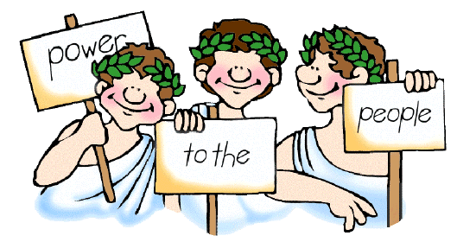
DEMOCRACY
(11) Government where the people are the primary source of power

Slide 13
COUP D’ETAT
(12) The sudden overthrow of a government by a usually small group of people in positions of authority

Slide 14
REIGN OF TERROR
(13) The period (1793-1794) of the French Revolution during which many people were executed for opposing the revolution

Slide 15
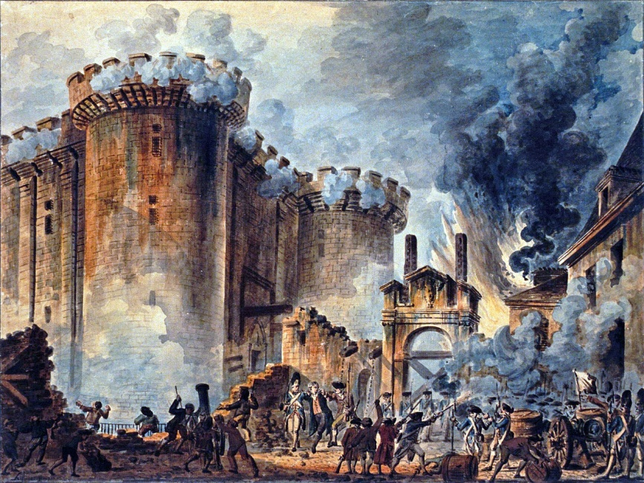
BASTILLE
(14) A prison that held political prisoners; French citizens attacked it on July 14, 1789 to show anger against the government

