Slide 2
PAN-AFRICAN
Movement
© Brain Wrinkles

Slide 3
Colonization
By the 20th century, European powers had colonized the majority of Africa.
The only independent countries were Liberia and Ethiopia.
Liberia was founded in 1822 by former American slaves.
© Brain Wrinkles

Slide 4
Nationalism
Africans resented their unequal status and lack of political rights under European control.
They wanted to take control of their own governments, land, and resources.
Nationalism, a feeling of strong pride in one’s own country, began to sweep across Africa and fed the desire for independence from European rule.
© Brain Wrinkles

Slide 5
Pan-African
An example of African nationalism was the Pan-African movement that began in the late 1800s.
The movement believed that all Africans shared a common heritage and should work together for their freedom.
The Pan-African movement’s principles actually dated back to the slave trade era.
The first Pan-African Congress occurred in 1900.
© Brain Wrinkles

Slide 6
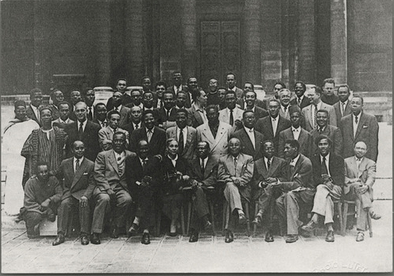
Pan-African Congress Delegates
© Brain Wrinkles

Slide 7
Pan-African
By the end of World War II, four more meetings had occurred.
The fifth Pan-African Congress counted in 90 delegates, including the future leaders of Kenya and Ghana.
Eventually, the influence of the movement began to fade, but not before pushing the cause of nationalism forward.
© Brain Wrinkles

Slide 8
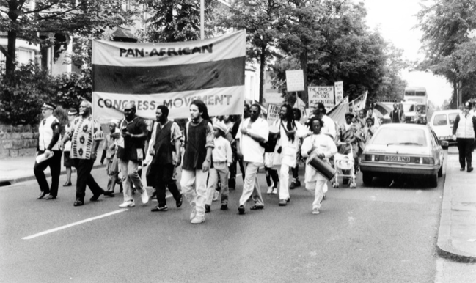
© Brain Wrinkles

Slide 9
Changes
Africa began to change by the 1940s.
The rule of tribal chiefs had weakened because of their links with colonial governments, thus limiting their ability to control people.
An educated middle class that disliked colonial life began to grow in the cities.
© Brain Wrinkles

Slide 10
Unrest
The cost for European countries to maintain colonies was rising.
By the second half of the century, unrest arose throughout the continent and African nations fought to free themselves from European control.
© Brain Wrinkles

Slide 11
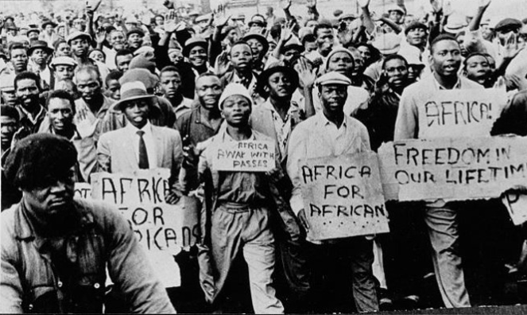
© Brain Wrinkles

Slide 12
Africa Today
By 1966, all but six African countries were independent nation-states.
Unfortunately, once the countries were independent of European rule, they still faced many challenges.
Many of the new governments were politically unstable.
© Brain Wrinkles

Slide 13
Africa Today
European powers did not teach new leaders how to self-govern after granting them independence.
Ethnic groups continue to clash over political power in many African nations.
In some African countries, military dictators took over the governments.
© Brain Wrinkles

Slide 14
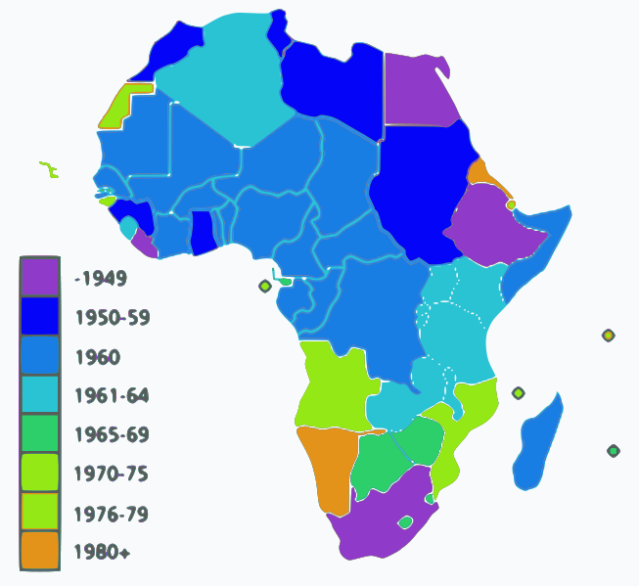
African Independence Dates
© Brain Wrinkles

