Slide 1
HUMAN RIGHTS & GLOBALIZATION Vocabulary
Directions: Confirm or correct your responses on your vocabulary worksheet

Slide 2
GLOBALIZATION
(1) The process of creating an international network of trade, communication and culture

Slide 3
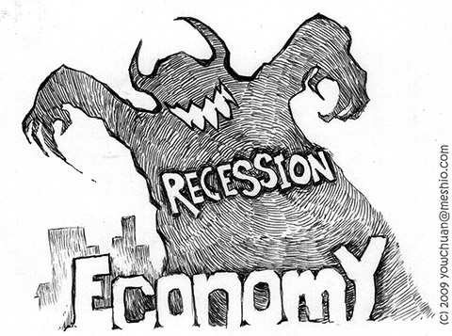
RECESSION
(2) A period of temporary economic decline during which trade and industrial activity are reduced

Slide 4
INTERDEPENDENCE
(3) The quality or condition of being mutually reliant on each other

Slide 5
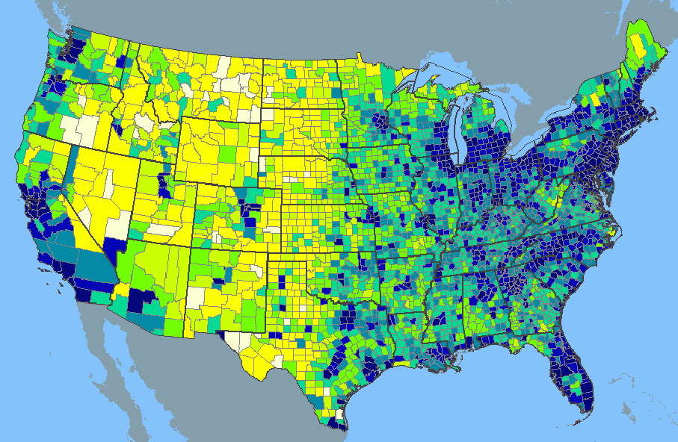
POPULATION DENSITY
(4) The number of people in a given land area

Slide 6
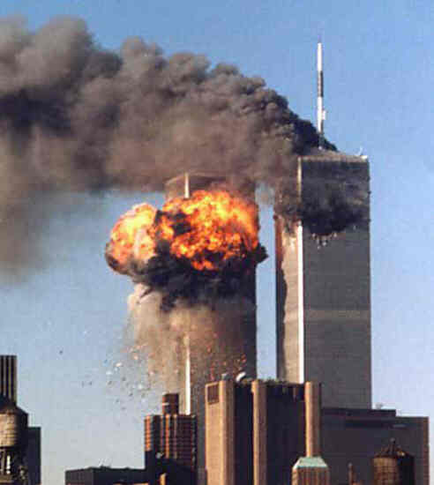
TERRORISM
(5) The deliberate use of violence, often against civilian targets, to achieve political or social goals

Slide 7
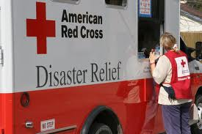
HUMANITARIAN AID
(6) Material or logistical assistance provided to improve human welfare; the goal is to save lives, ease suffering, and maintain human dignity

Slide 8
SANCTIONS
(7) A penalty applied against a country in order to pressure it to change its policies

Slide 9
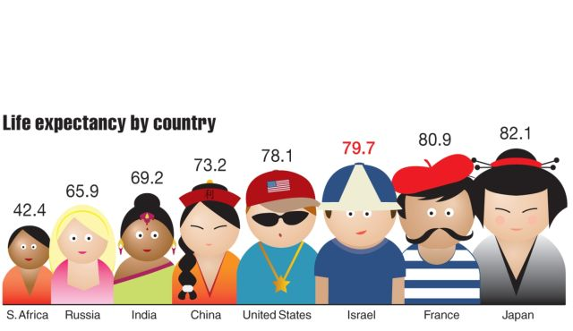
LIFE EXPECTANCY
(8) The average period a person can expect to live in a specific country

Slide 10
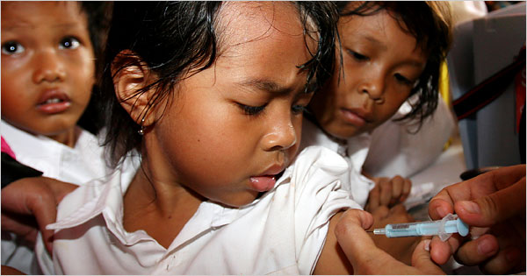
CHILD MORTALITY
(9) The deaths of infants and children under five in a specific country

Slide 11
MULTINATIONAL CORPORATION
(10) A business with facilities in more than one country

Slide 12
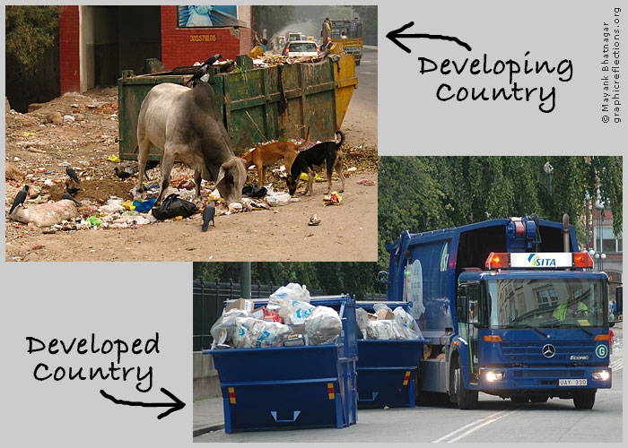
DEVELOPING COUNTRY
(11) A poorer country whose economy is less industrialized than those of highly developed countries.

Slide 13
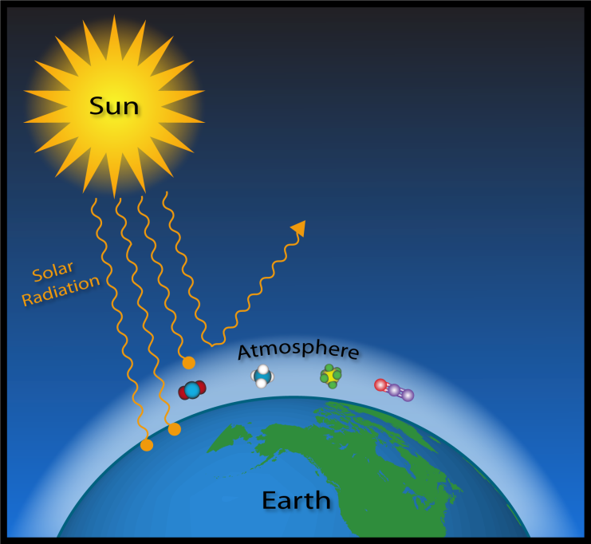
GREENHOUSE EFFECT
(12) The trapping of the sun’s heat in the lower atmosphere, caused by the presence of carbon dioxide and other gases

Slide 14
GLOBALIZATION ACTIVITY
Objective: I can answer ten essential questions about globalization

Slide 15
DIRECTIONS: Part One
Read your group’s assigned question and answer.
With your group members, condense the answer to your question into a 1-2 sentence summary. Remember, it’s your job to teach the class the answer to this question.
Write your 1-2 sentence answer on the mini-poster.
Get ready to present your answer to the class!

Slide 16
Directions: Part Two
As groups present, fill in the 1-2 sentence
answer on your Globalization: FAQ Activity
Page.

