Slide 1
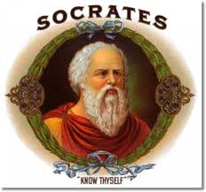
Students listen closely to the comments of others, think critically for themselves, and articulate their own thoughts and their responses to the thoughts of others. The goal of a Paideia seminar is for students to help one another understand the ideas, issues, and values reflected in a specific text or texts.
What is it?
The Paideia seminar is a formal discussion based on a text. The participants gain a deeper understanding of concepts in one or more texts through thoughtful dialogue.
How does it work?
Why do it?
The Paideia seminar is rooted in the teachings of the classical Greek philosopher, Socrates.
Philosophers are basically people who seek to understand core truths about themselves, the world in which they live, and their relationships to the world and to each other.
(Click picture for link to video)

