Slide 1
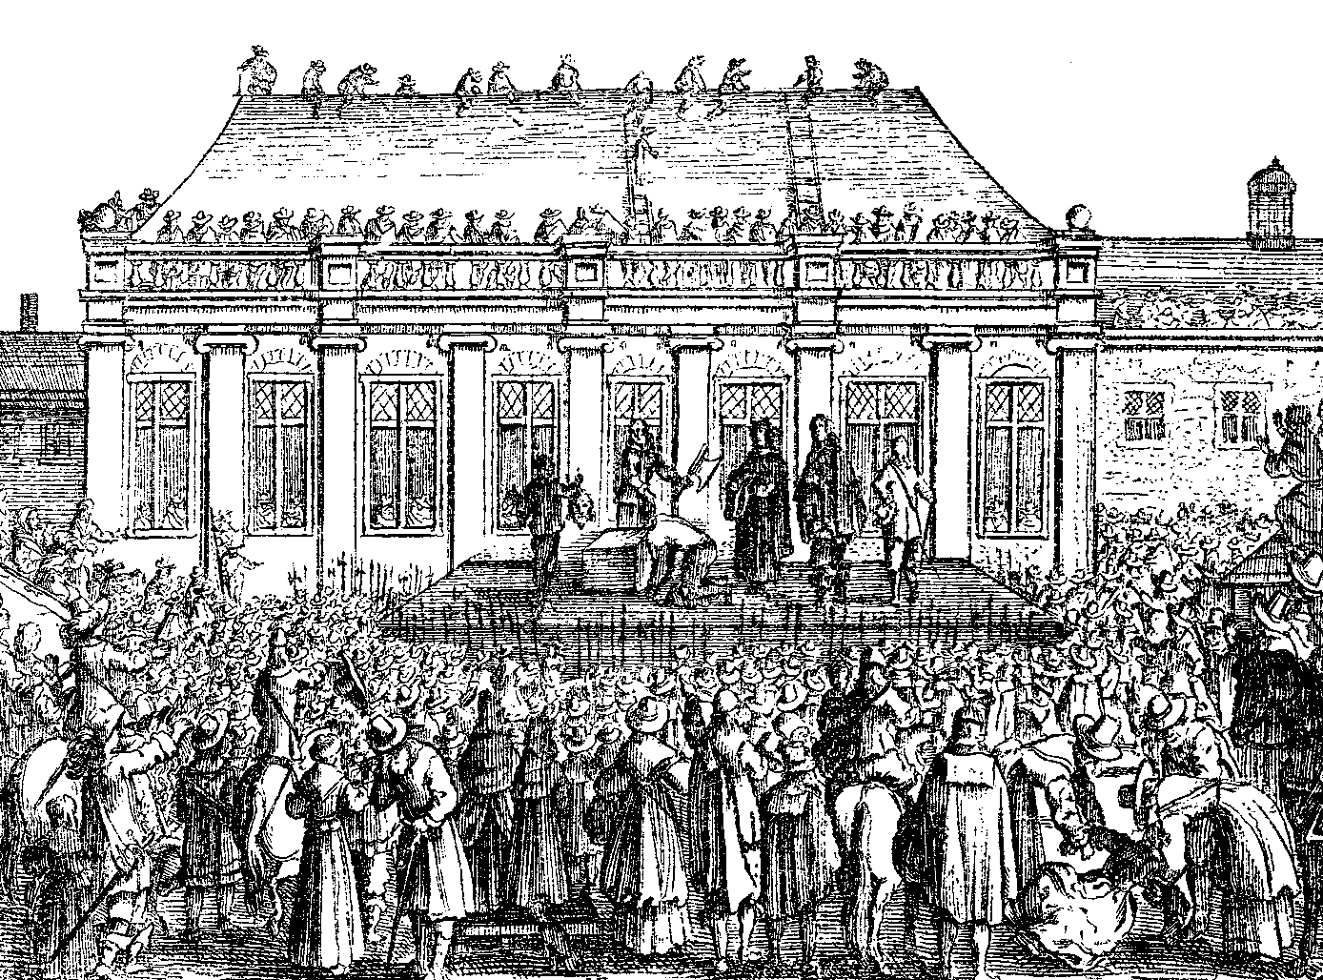
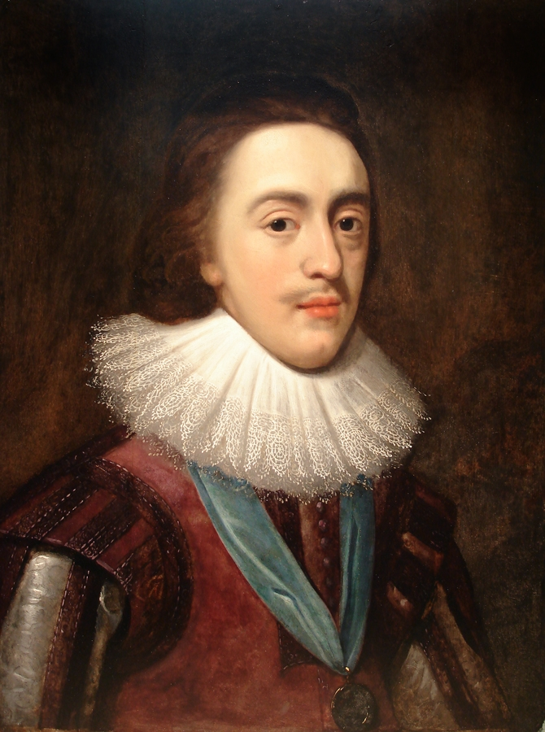
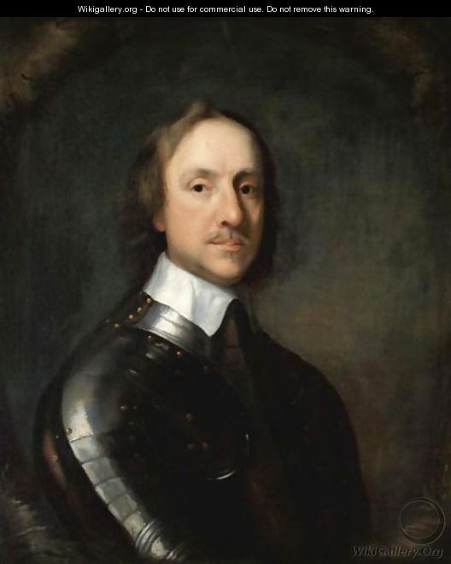
The Trial of Charles I
Directions: Today we will examine the evidence in the trial of Charles I, and you will create a verdict based on your interpretation of the evidence.

Slide 2
TREASON
What is treason?
THE CRIME OF BETRAYING ONE’S COUNTRY

Slide 3
How did Charles betray his country?
How did Charles commit treason according to the people of England AND Parliament?
What is Charles’ defense to the charges brought against him?

Slide 4
Court proceedings
What is the PROSECUTION?
The Prosecution is the lawyers bringing charges against the King (supported by Parliament and the people of England)
What is the DEFENSE?
The Defense are the lawyers presenting the arguments of King Charles I and why he did not commit the charges brought against him

Slide 5
Now the case is yours to decide…
You have to decide the fate of King Charles. Based on the evidence in front of you, evaluate whether you would find Charles I guilty or not guilty of TREASON. Then you must decide the punishment.
Here are the four choices for your verdict:
Charles is GUILTY of treason and deserves to die
Charles is GUILTY of treason and doesn’t deserve to die - he should be sent out of the country
Charles is NOT GUILTY of treason but should not be King anymore
Charles is NOT GUILTY of treason and should be made King again
Write a paragraph (minimum 5 sentences) explaining your ruling on the bottom of the Trial of Charles I worksheet. (Hint- use your evidence to explain WHY you chose your verdict and punishment)

